Slide 1

ELECTROCYCLIC REACTIONS
MY SRC, MY PRIDE
Dr.T.Vimala
Associate Professor,
Department of Chemistry,
Seethalakshmi Ramaswami College,
Tiruchirappalli – 620002
Tamil Nadu.

Slide 2

Reactions which proceed in a single concerted step via the formation of a cyclic transition state involving π or σ electrons are called pericyclic reactions.
Types of Pericyclic Reactions:
Electrocyclic reactions
Cycloaddition reactions
Sigmatropic rearrangement
Pericyclic Reactions

Slide 3
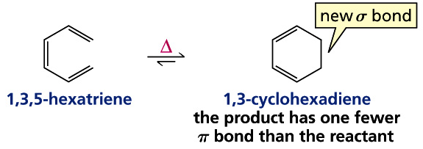
Electrocyclic Reactions
These are reversible reactions in which a compound with conjugated double bonds undergoes cyclisation. In this process two pi- electrons are used to form a sigma bond.

Slide 4
Frontier Molecular Orbitals (FMO)
(Kenichi Fukui)
HOMO and LUMO are called Frontier Molecular Orbitals (FMO).
In electrocyclic reactions there is formation of a sigma bond at the two terminals of the polyene. Therefore the two terminals of the pi orbitals of HOMO should be rotated for head on overlapping which results a sigma bond.

Slide 5
Four π molecular orbitals of 1,3-butadiene
Energy

Slide 6
Cyclisation Involving The Formation Of A New Simga Bond
Conrotatory
The two terminal orbitals rotated in the same direction, either clockwise or anticlockwise.
Disrotatory
The two terminal orbitals rotated in the opposite direction.
conrotatory
HOMO of 1,3-butadiene

Slide 7
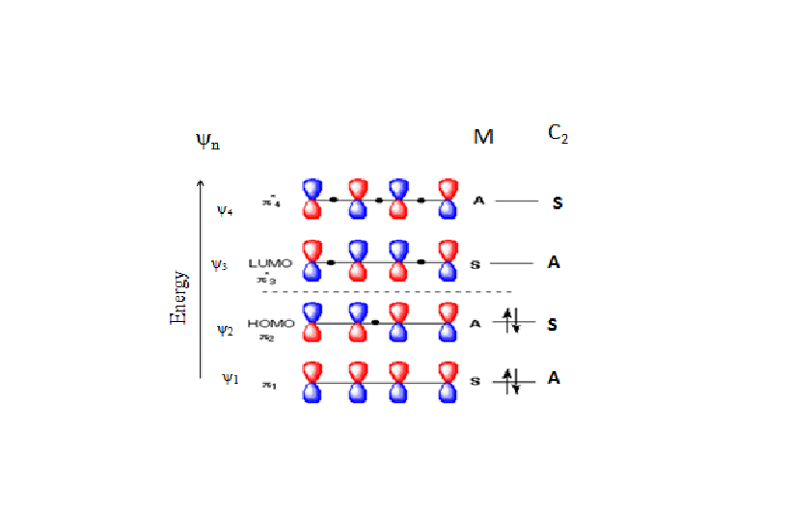

Cyclisation of 1,3-butadiene
By Thermal Process
_{Δ}

Slide 8
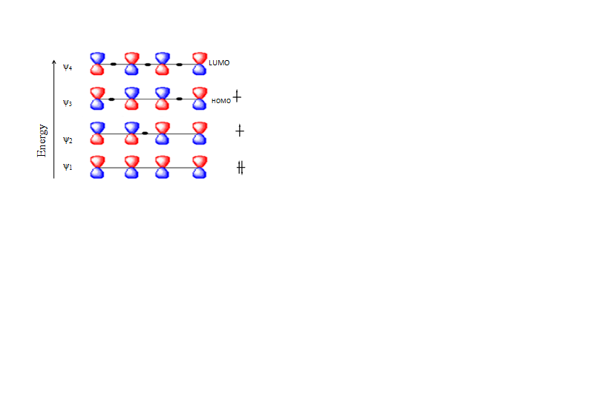
Cyclisation of 1,3-butadiene
By Photochemical Process
hʋ
Ψ_{3, HOMO}

Slide 9
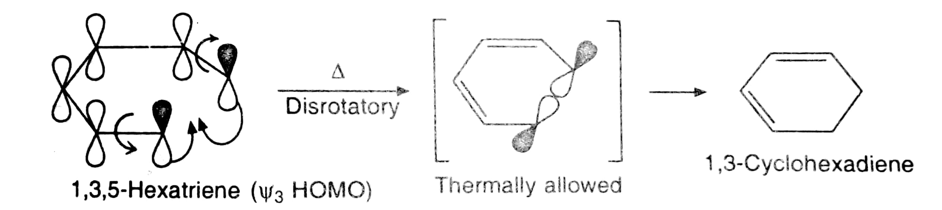
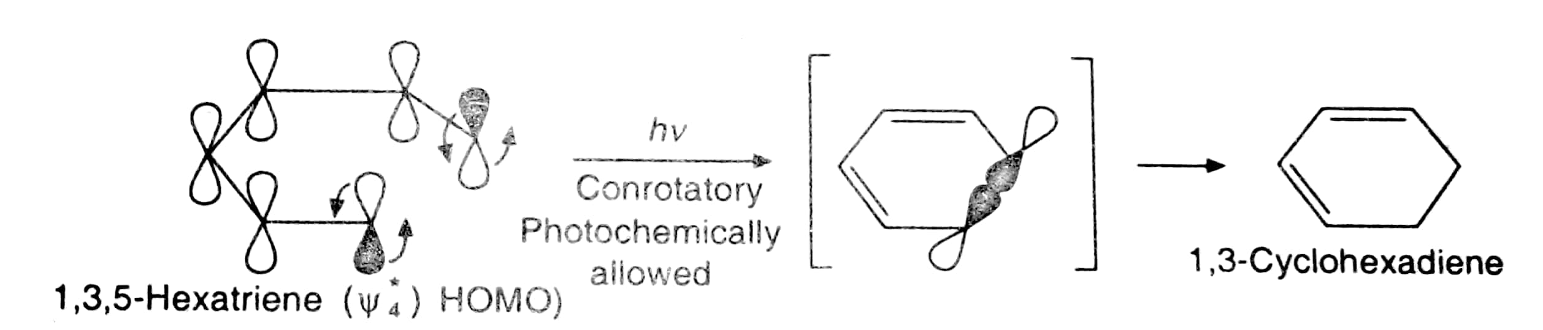
Thermal And Photochemical Cyclization Of 1,3,5-hexatriene

Slide 10
Woodward Hoffman Rules For Electrocyclic Reactions
No. of ground state electrons | Thermal Reaction | Photochemical Reaction
4n π | Conrotatory | Disrotatory
(4n+2) π | Disrotatory | Conrotatory

Slide 11
Thank You

